Slide 1

New User Seminar

Slide 2
Research Computing New User Seminar
Instructor:
Website: www.rc.colorado.edu
Helpdesk: rc-help@colorado.edu
Slides: https://github.com/ResearchComputing/New_User_Seminar
Survey: http://tinyurl.com/curc-survey18

Slide 3
Account Check
Does anyone not have a CU Research Computing account who would like to use a temporary account*?
*only available during seminar

Slide 4
Learning Goals
What is CU Research Computing (CURC)?
Understand Basic Resources
Getting an account & logging in
Navigate the RC system
Run a job
Help!

Slide 5

Things to Take Note Of
Confusing, ambiguous, highly nuanced concepts
Goal is to avoid common mistakes, pitfalls, and frustrations
Ask Questions!

Slide 6




CU Research Computing provides
Large-scale, beyond-the-desktop computing resources for the University of Colorado and more!

Slide 7


Resources include:
High Performance Computing
Storage of Research Data
High-Speed Data Transfer
Data Sharing
Cloud Computing
Training & Education

Slide 8
Primarily known for:
High Performance Computing (HPC)

Slide 9

High Performance Computing (HPC)
vs. Traditional Computing
Traditional computing generally has access to a single processor (perhaps multiple cores)

Slide 10
High Performance Computing (HPC)
vs. Traditional Computing
HPC is a network (or cluster) of hardware we call “nodes” linked together with high-speed interconnects

Slide 11

High Performance Computing (HPC)
HPC is a multiprocessor environment that allows users to run jobs on several processors at once (also called parallel processing)

Slide 12
What can I use HPC for?
Solving large problems that require more:
Memory than you have on your PC
cores/nodes/power thank you have on your PC
Jobs that require hardware you may not have:
High Performance GPU computing
Specific Operating System
Visualization rendering

Slide 13


Puzzle Analogy
Working on a puzzle by yourself (although enjoyable!) will take time, even if you’re fast!

Slide 14
You can speed it up by inviting friends over and enticing them with food
What happens if there are too many people?

Slide 15
What can I use HPC for?
Jobs that would take a long time on local machines can instead be distributed over hardware:
Parallelized to split up then joined (if software enabled)
Broken up into many serial jobs
BIG Job
Tiny Job
Tiny Job
Tiny Job

Slide 16
Research Computing Resources

Slide 17
HPC Clusters at CURC
Blanca
Summit

Slide 18
NSF-Funded
Shared
450+ Nodes (mostly Intel Xeon Haswell)
24 cores per “shas” (general compute) node
Additional Node types:
10 GPU Nodes (NVIDIA Tesla K80)
5 High Memory Nodes (2TB ram)
20 Intel Xeon Phi nodes
11,400 total cores
Summit

Slide 19
Blanca
Buy-in Cluster
Per user specs and vendor constraints
High priority use on your hardware
Preemptable use to all other nodes
Heterogenous
~223 Compute Nodes
~10 GPU nodes

Slide 20
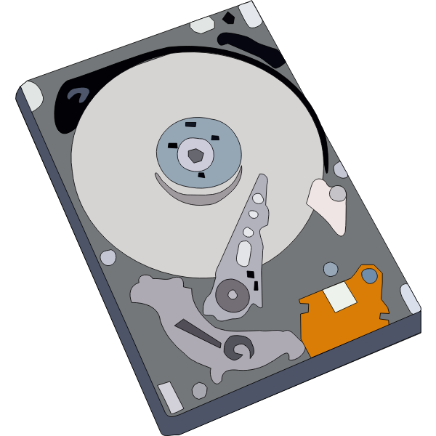

Storage at CURC
PetaLibrary
Local or Cloud
Core
Included with RC account
/home
/projects
scratch space
You can download your data locally or to a variety of other cloud resources
Paid Service for:
Storage
Archive
Sharing of research data

Slide 21
Data Sharing: Within RC
Sharing workspaces
Project space
Scratch space
PetaLibrary space

Slide 22
Data Sharing: Outside RC
Globus (recommended):
GUI Web Application
Automates large transfers
Resumes failed transfers
Distributes large transfers across DTNs
Endpoints that can shared
Data Transfer Nodes (DTN)
Internal CU network needed
Command line tools
scp, sftp, rsync, rclone

Slide 23
Accessing Research Computing

Slide 24
How to Access RC Resources?
Get an account
Set up two factor authentication
(Inform us of any specific needs)
Log in
Create greatness! (responsibly)

Slide 25
Getting an account
CU Boulder users and affiliates:
Request an account through the RC Account request portal
https://rcamp.rc.colorado.edu/accounts/account-request/create/organization
CSU Users:
Request an CSU eID if you don’t have one
Fill out account application form
Duo authentication
Then get an RC user account
https://www.acns.colostate.edu/hpc/summit-get-started/
RMACC Users:
Contact your local representative, if known. Email rc-help@colorado.edu
We’ll guide you through the process

Slide 26
Demo: Getting an Account
CU Boulder users and affiliates:
Request an account through the RC Account request portal
https://rcamp.rc.colorado.edu/accounts/account-request/create/organization

Slide 27
Your RC Account
Access to:
Summit Cluster (soon Alpine)
“Core” storage
PetaLibary Storage (if applicable)
Gateways (CU affiliates)

Slide 28
Two Factor Authentication
Provides an extra level of authentication
We are outside the firewall!
Valuable resources
Inviting, high-profile target
Lost time investigating/fixing
Duo
You will receive a Duo invitation when your RC account is created.

Slide 29
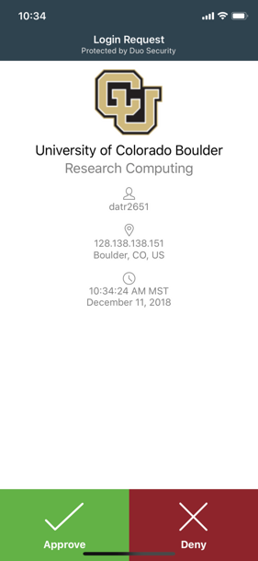
Duo Authentication
Most users use the Duo smartphone app
“Phone Call” is an alternatives
Physical code generator “token” available for $20

Slide 30
Linux comfort level check!
On a scale from (1-10) how familiar/comfortable are you with Linux?
The command line
Basic commands
Linux filesystem
Navigating the filesystem

Slide 31
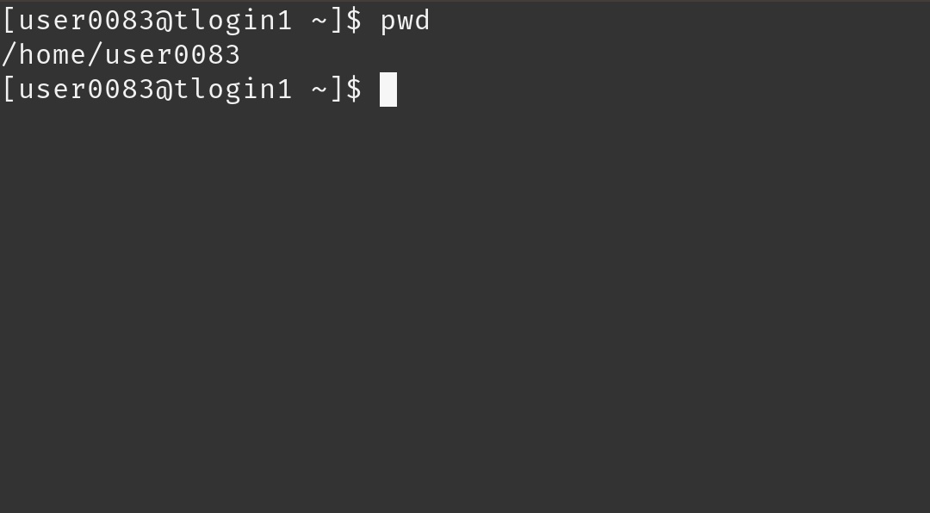
Terminal
Mac or Linux
Terminal application
Windows
PuTTY (recommended)
Powershell
Open OnDemand (alternative for CU affiliates)
For those less familiar with Linux (ondemand.rc.colorado.edu/)

Slide 32
Demo: Logging in via Terminal
To login to an RC login node:
ssh <username>@login.rc.colorado.edu
Supply your IdentiKey password and your Duo app will alert you to confirm the login
If you’re using a tutorial account:
ssh <username>@tlogin1.rc.colorado.edu

Slide 33
Demo: Logging in with OnDemand

Slide 34
Logging In
It’s important to note that you are NOT logging into any specific resource, Summit, etc.
When you log in, you land on our login nodes
From there, you can access our other resources

Slide 35
Navigating Research Computing

Slide 36
Node | File System
One computing server Physical hardware Work together in parallel | The basic tree-like layout From most nodes* you have access to the entire file system
/
d1
d2
d3
d4
f1
f2
Notes:
Nodes are used because there are different needs for hardware - some basic functionality, some very intensive functionality

Slide 37
Node | File System
One computing server Physical hardware Work together in parallel | The basic tree-like layout From most nodes* you have access to the entire file system
/
d1
d2
d3
d4
f1
f2
Notes:
Nodes are used because there are different needs for hardware - some basic functionality, some very intensive functionality

Slide 38
Node Types
Login | Compile | Compute
Where you start For editing code, job submission No heavy computation | Where you compile code, install packages Explore the Summit software environment Edit code, submit jobs No heavy computation | Where scheduled jobs run Intended for heavy computation
Ex. edit job script | Ex. Install python libs | Ex. Running Matlab

Slide 39
Demo: Exploring nodes
Once logged in:
$ ssh scompile
To log in to a compile (or head) node.
$ module avail
To check currently available software

Slide 40
File system map
/home/<user>
Node
/
/projects/<user>
/scratch/summit/<user>
/pl

Slide 41
File Structures
/home (2GB) | /projects (250GB) | Scratch (10TB)
Scripts, Code, Small, important files/directories Not for sharing files or job output | Code/files/libraries Software you are installing Sharing files Not for job output | Output from running jobs Large files/datasets Sharing files Not for long term storage
Ex .bashrc | Ex. Shared job scripts | Ex. Data

Slide 42
Demo: Exploring the Filesystem
Once logged in:
cd /home/<user>
cd /projects/<user>
cd /scratch/summit/<user>
To navigate to your different directories

Slide 43
Using Research Computing
We have logged on
We have explored nodes and filesystem
But how do we actually use the computing resources?

Slide 44
Running a Job

Slide 45
The fundamental “job”
What is a “job”?
Work for the cluster to perform on
Batch jobs
Submit job script which will be executed when resources are available
Create script containing information about the job
Submit the job file to a queue
Interactive jobs
Work interactively at the command line of a compute node
Notes:
Cookie analogy** describing a batch job
Limitations of interactive jobs

Slide 46
Job Scheduling
Computer
Hardware
Submit Job
Management
service
Get Results
Storage
Notes:
As a user you want to a) submit a job (analysis to run) then, eventually b) get the results
Behind the scenes things can be broken down into 3 main parts
A management service that help distribute job loads because this is a shared resource
Hardware to actually perform the computation
Storage for software, system information, your data

Slide 47
Job Scheduling
Computer
Hardware
Submit Job
SLURM
Get Results
Storage
Notes:
As a user you want to a) submit a job (analysis to run) then, eventually b) get the results
Behind the scenes things can be broken down into 3 main parts
A management service that help distribute job loads because this is a shared resource
Hardware to actually perform the computation
Storage for software, system information, your data

Slide 48
Your first job
/home/<user>
Where to write it?
How to write it?
How to run it?
/projects/<user>
Scratch space
Notes:
demo

Slide 49
Job Script: 3 main parts
Directives
Specify resource requirements
Software
Because jobs run on a different node than from where you submitted…
…software that is needed must be loaded via the job script
User scripting
the actual user scripting that will execute when the job runs
#!/bin/bash
## Directives
#SBATCH --<resource>=<amount>
## Software
module purge
## User Scripting

Slide 50
Directive Options
http://slurm.schedmd.com/sbatch.html
#SBATCH <options> sbatch <options>
Allocation: --account=<account_no>
Partition: --partition=<partition_name>
Sending emails: --mail-type=<type>
Output file: --output=<file name> (%j gives you job id)
Number of nodes: --nodes=<nodes>
Number of tasks: --ntasks=<processes>
Quality of service: --qos=<qos>
Reservation: --reservation=<name>
Wall time: --time=<wall time>
Job Name: --job-name=<jobname> ...etc...
FYI: You do NOT actually type <> above – this designates something specific you as a user must enter about your job

Slide 51
Writing a Job: hostname.sh
Submit a slurm job with the following instructions:
The job will be submitted from a bash script named hostname_summit.sh
The job will run on 1 node
Request 1 minute wall time
Run on the shas-testing partition
Output should contain job id
The job should run the Unix “hostname” command

Slide 52
Writing a Job: Hostname
Set up job boilerplate (nano or vim):
#!/bin/bash
## Directives
#SBATCH --<resource>=<amount>
## Software
module purge
## User Scripting

Slide 53
Writing a Job: Hostname
Directives:
1 node
1 minute wall time
“shas-testing” partition
Output should contain job id
Number of nodes:
--nodes=<nodes>
Wall time:
--time=<wall time>
Partition:
--partition=<partition_name>
Output file:
--output=<file name>
(%j gives you job id)

Slide 54
Writing a Job: Hostname
Software:
Do we need any software? (modules)
User script:
What command do we want to run?

Slide 55
Demo: Writing Hostname

Slide 56
Demo: Writing Hostname
#!/bin/bash
#SBATCH --nodes=1 # Number of requested nodes
#SBATCH --time=0:01:00 # Max wall time
#SBATCH --partition=shas-testing # Specify Summit haswell nodes
#SBATCH --output=hostname_%j.out # Rename standard output file
# purge all existing modules
module purge
hostname

Slide 57
Submitting a Job
Load up the slurm module (default)
module load slurm/summit
Submit the job:
sbatch <script name>.sh
Check output

Slide 58
Review: Learning Goals
Why High Performance Computing (HPC)?
Understand Basic Resources
Get an account & log in
Navigate the RC system
Run a job
Help!

Slide 59
Help! I’m stuck, where do I go?
Documentation: curc.readthedocs.io/
Trainings with Center for Research Data and Digital Scholarship (CRDDS): https://www.colorado.edu/crdds/
Helpdesk: rc-help@colorado.edu

Slide 60
Questions

Slide 61
Survey and feedback
http://tinyurl.com/curc-survey18

